Slide 1



Docker Workshop – 1
By Zama

Slide 2
Agenda
What is Docker
Docker vs Virtual Machine
Core concepts
Hands-on
Dockerize a simple runnable jar
Dockerize spring boot app
Setup docker hub (public docker registry) account
Upload docker image from local to docker hub

Slide 3
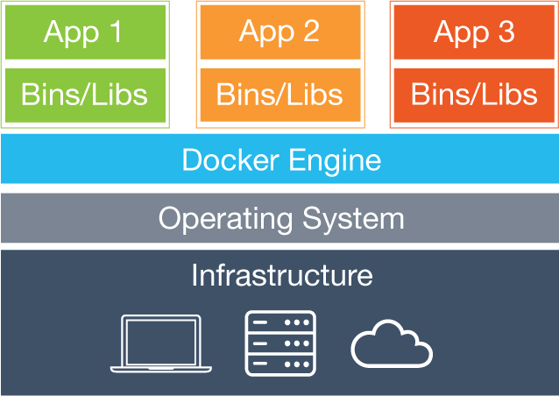
Definition
According to Wikipedia:
an open-source project that automates the deployment of software applications inside containers by providing an additional layer of abstraction and automation of OS-level virtualization on Linux
Simplified version:
Docker is a tool that allows developers, sys-admins etc. to easily deploy their applications in a sandbox (called containers) to run on the host operating system

Slide 4
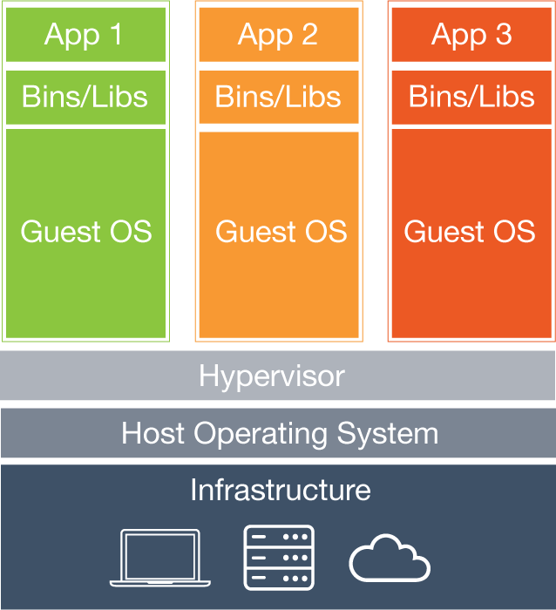
Virtual Machine vs Docker
Virtual Machines
Each virtual machine (VM) includes the app, the necessary binaries and libraries and an entire guest operating system
Containers
Containers include the app & all of its dependencies, but share the kernel with other containers
Run as an isolated process in userspace on the host OS
Not tied to any specific infrastructure – containers run on any computer, infrastructure and cloud.

Slide 5
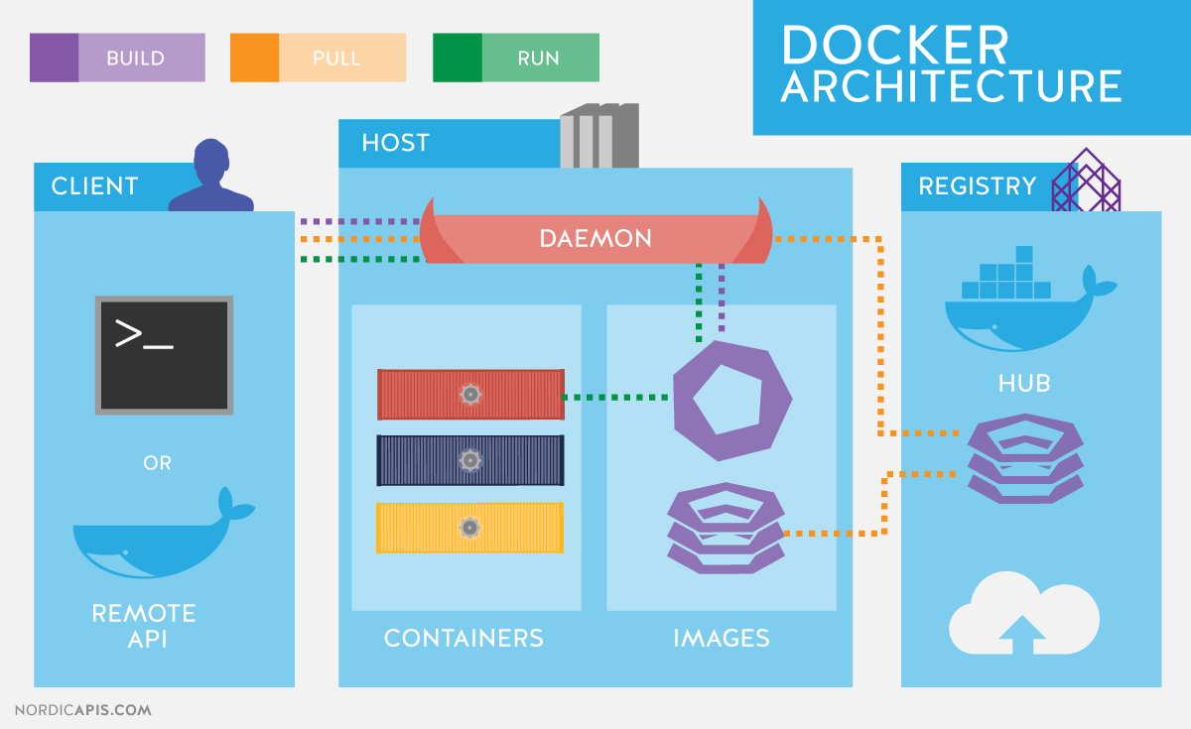
Core Concepts: Architecture

Slide 6
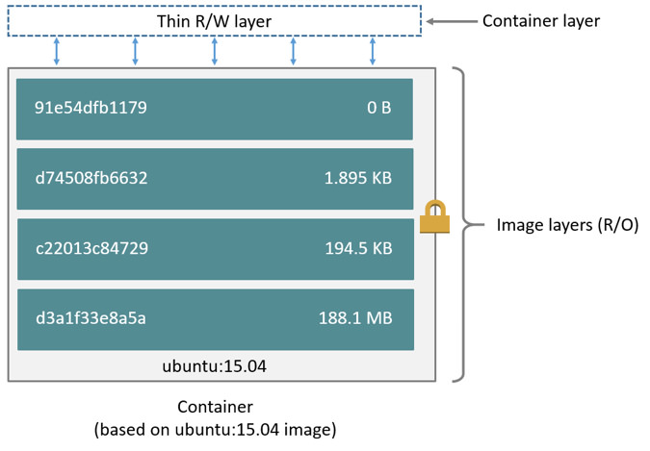
Core Concepts: Image
Dockerfile
FROM ubuntu:15.04
COPY . /app
RUN make /app
CMD python /app/app.py

Slide 7
Core concepts: Container Life-cycle
Conception: BUILD an Image from a Dockerfile
Birth: RUN (create and start) a container
Sleep: STOP a running container
Wake: START a stopped container
Death: RM (delete) a stopped container

Slide 8
Hands-on: Assignment 1 – Runnable jar
Run the app without docker
Dockerize the runnable jar
Build docker image
Run the app with docker
Push the image to Docker Hub (Public docker registry)
Verify in another machine

Slide 9
Hands-on: Assignment 2 – Spring boot
Run the spring boot app without docker
Dockerize the spring boot app
Build docker image
Run the app with docker
Push the image to Docker Hub (Public docker registry)
Verify in another machine

Slide 10
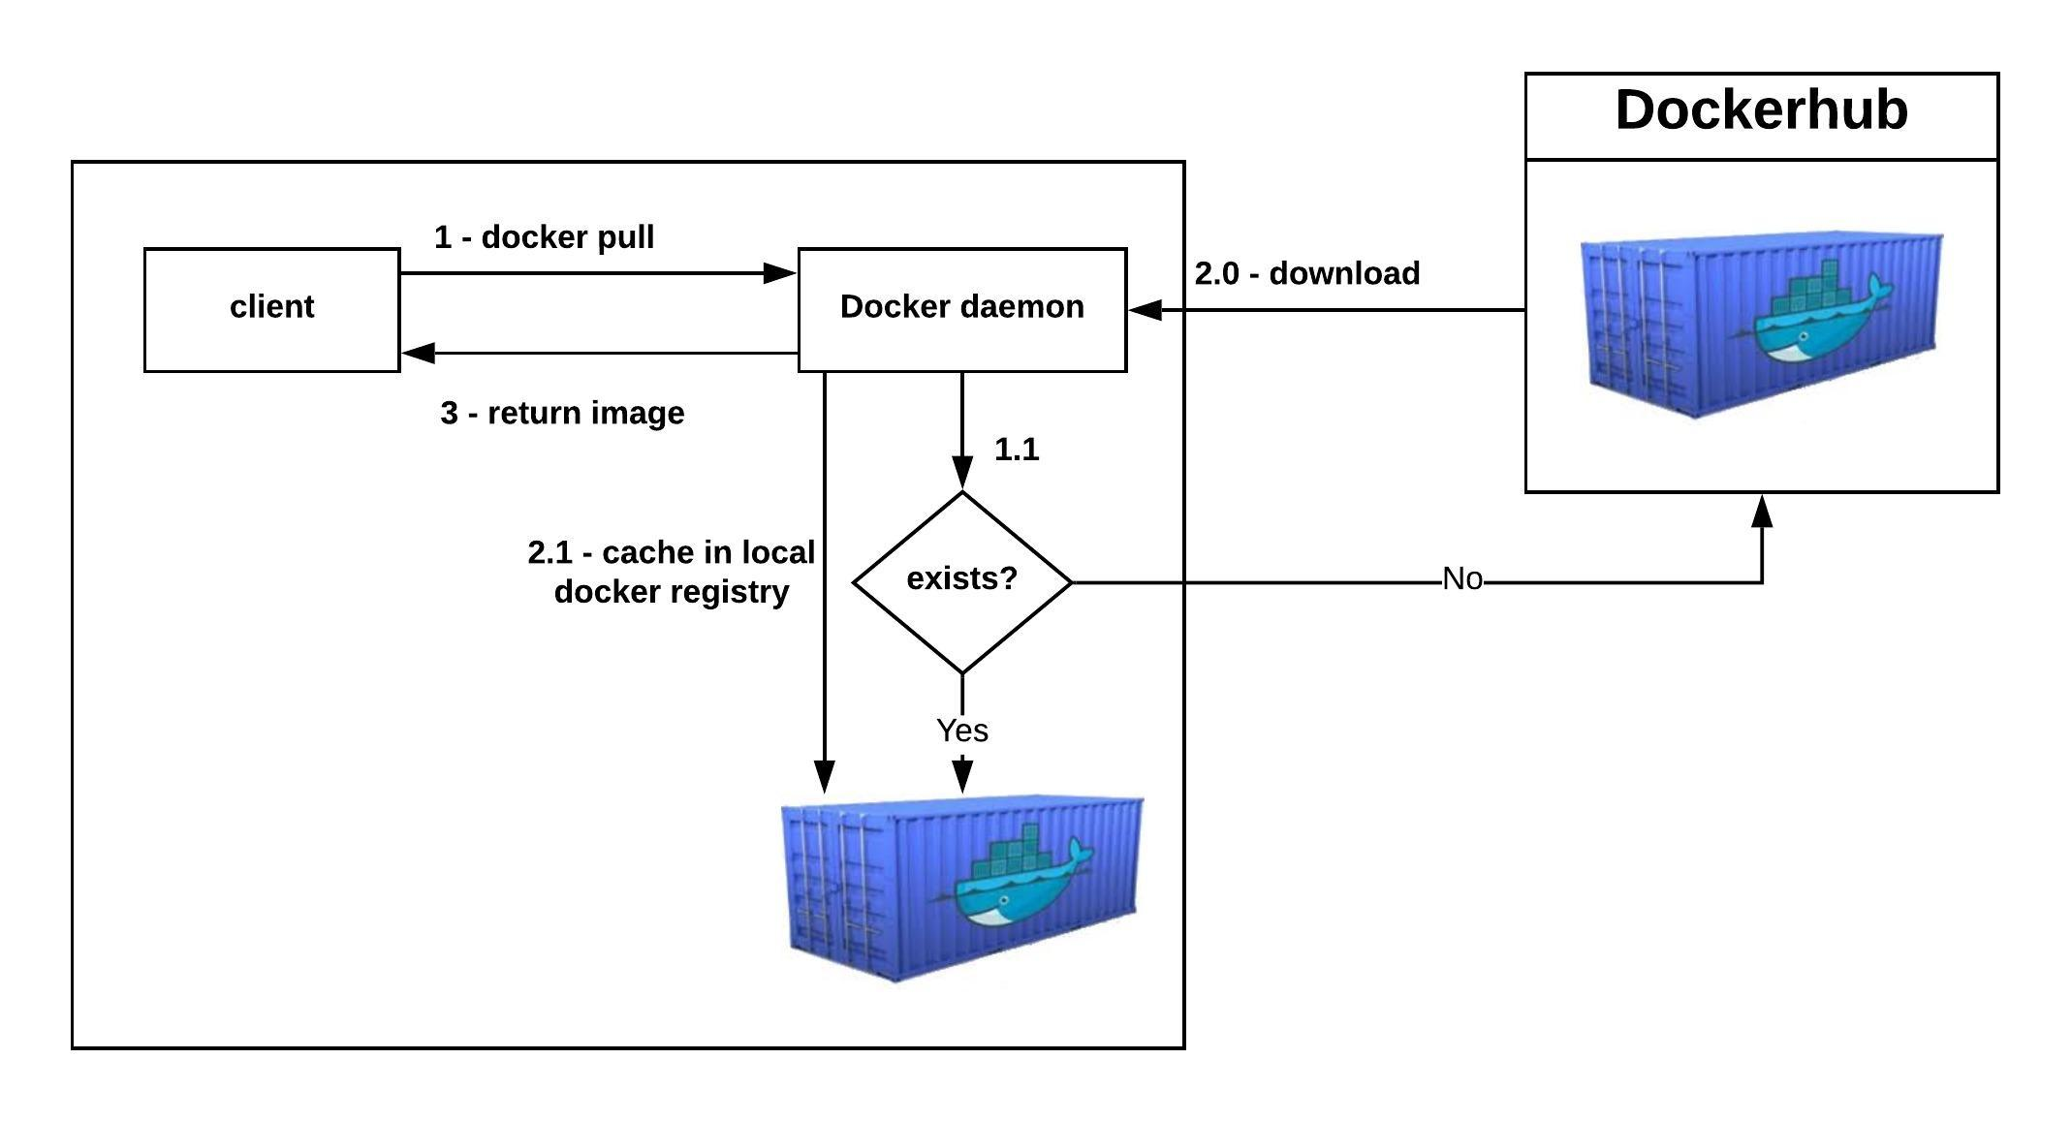
Hands-on: Download docker image

Slide 11
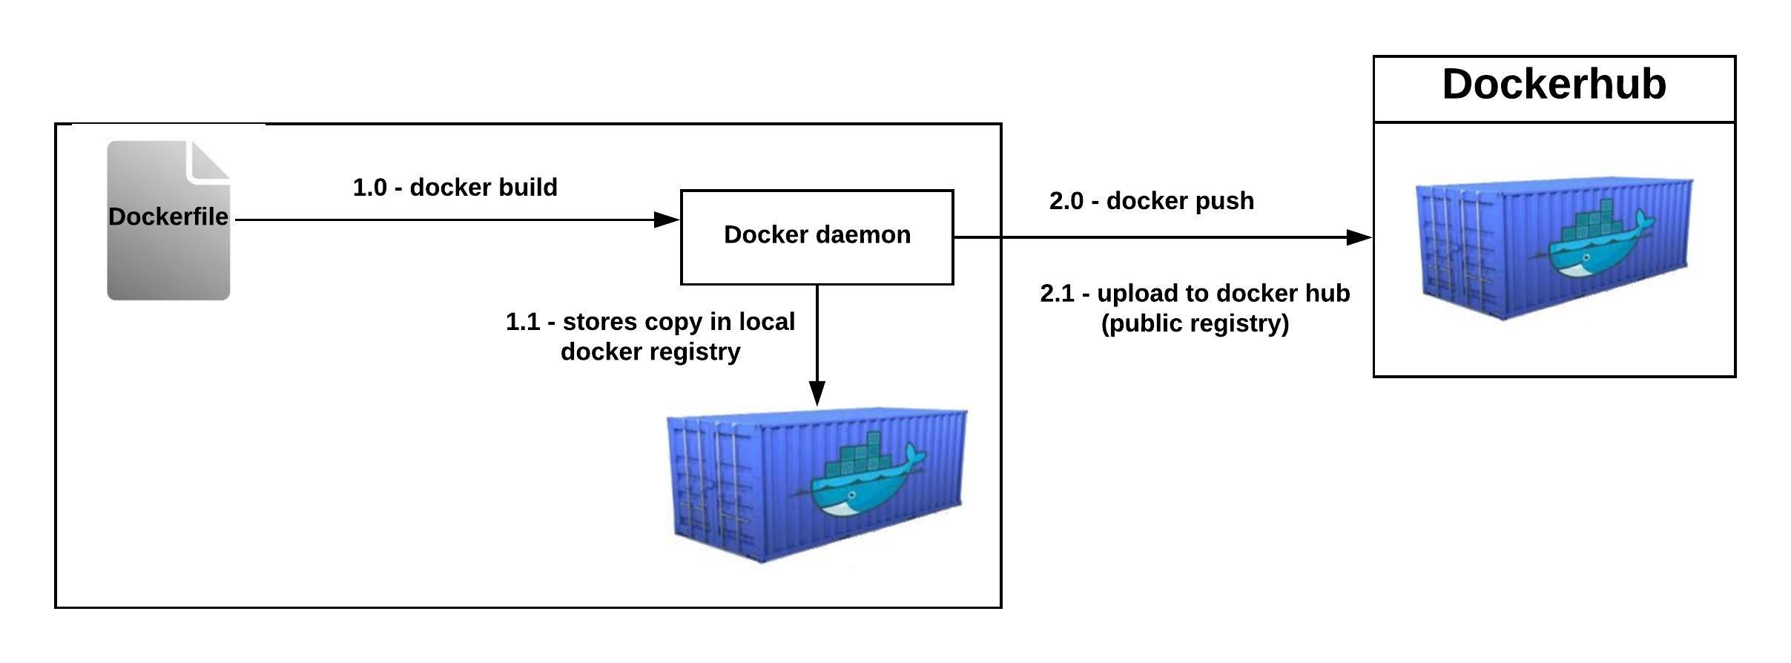
Hands-on: Upload docker image

Slide 12
Resources
Instructions and source code for the hands-on is available at this location:
https://github.com/mbzama/docker-training/

Slide 13
Thank You
Notes:
<number>

